Slide 1
Chapter 2
Program Correctness and Efficiency

Slide 2
Chapter Objectives
To understand the differences between the three categories of program errors
To understand what it means to throw an exception and how to throw an exception in a function
To understand the effect of an uncaught exception and why you should catch exceptions
To learn how to catch and process exceptions
To understand different testing strategies, and when and how they are performed

Slide 3
Chapter Objectives (cont.)
To learn how to write special functions to test other functions and classes
To become familiar with debugging techniques and debugger programs
To be introduced to the process of program verification, and the use of assertions and loop invariants
To understand the meaning of big-O notation and how it is used to analyze an algorithm's efficiency

Slide 4
Program Defects and "Bugs"
Section 2.1

Slide 5
Program Defects and "Bugs"
Defects that occur in software products after delivery can produce undesirable and sometimes disastrous results
Testing is used to show that a program is correct, but
it is difficult to determine how much testing needs to be done
testing can never demonstrate the complete absence of defects
complete testing in some environments (missile control software, nuclear power plant controls) is very difficult

Slide 6
Program Defects and "Bugs" (cont.)
The term "bug" is used to refer to a software defect, but many professionals feel that the term "bug" trivializes defects that can have serious consequences
Debugging is a commonly used term for removing defects
A debugger is a testing tool that helps find defects
It is much easier to eliminate defects by careful design than through testing
You may encounter three kinds of defects or errors
Syntax errors
Run-time errors or exceptions
Logic errors

Slide 7
Syntax Errors
Syntax errors are mistakes in using the grammar (syntax) of the C++ language
The C++ compiler will detect most syntax errors during compilation
Some common syntax errors:
Omitting or misplacing braces that bracket compound statements
Invoking a member function that is not defined for the object to which it is applied
Not declaring a variable before using it
Providing multiple declarations of a variable
Not assigning a value to a local variable before referencing it
Not returning a value from a function whose result type is not void

Slide 8
Syntax Errors (cont.)
Unfortunately, the compiler may not detect syntax errors that are the result of typographical errors
Typographical errors, such as using = when you intended to use ==, may be valid syntax, but will not produce the intended result
(In the case of = instead of ==, the result is assignment instead of comparison)
Because a syntactically correct program can contain errors, careful review and testing are essential

Slide 9
Run-time Errors
Run-time errors occur during program execution
A run-time error occurs when the computer or the C++ run-time library detects an operation that it knows to be incorrect
Most run-time errors cause the operating system or run-time library to issue an error message and halt the program
Different computers, operating systems, and compilers handle these errors differently

Slide 10
Run-time Errors (cont.)

Slide 11
Run-time Errors: Division by Zero
The C++ standard states that the result of division by zero is undefined
By stating "undefined," the standard does not require the compiler or the run-time system to detect it (and it may vary by the computer, operating system, and compiler)

Slide 12
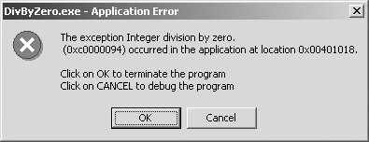
Run-time Errors: Division by Zero (cont.)
average = sum / count;
Under the Windows operating system, if the value of count is zero and this statement is executed, it will cause a division-by-zero error
The division-by-zero error is indicated by a dialog box:

Slide 13
Run-time Errors: Division by Zero (cont.)
average = sum / count;
Under the Linux operating system, you merely get the message:
Floating point exception

Slide 14
Run-time Errors: Division by Zero (cont.)
You can guard against such a division with an if statement:
if (count == 0)
average = 0.0;
else
average = sum / count;

Slide 15
Run-time Errors: Division by Zero (cont.)
Since division-by-zero errors occur in integer division, you could cast the int value in sum to type double before doing the division:
average = double(sum) / count;
On the Intel x86, average is assigned a special value, representing either positive or negative infinity, depending on the sign of sum

Slide 16
Array Index Out of Bounds
C++ does not check the validity of array subscripts
Attempting to access or modify an array element using a subscript that is negative or greater than or equal to the array's length is also an undefined condition

Slide 17
Array Index Out of Bounds (cont.)
If we define the following array,
int scores[500];
and we use the subscripted variable scores[i] with a value of i less than zero or greater than 499, a location in memory outside of the array will be accessed or modified
If the location happens to be a location not accessible to the program an error may be reported
Otherwise, the program may execute, but may exhibit strange behavior at some point possibly far removed from the location of the error

Slide 18
Array Index Out of Bounds (cont.)
Incorrect loop control parameters can cause array-index-out-of-bounds errors
We need to check carefully the boundary values for an index that is also a loop control variable
A common error is using the array size as the upper limit rather than the array size minus 1

Slide 19
Array Index Out of Bounds (cont.)
for (int i = 0; i <= X_SIZE; i++)
x[i] = i * i;
The loop above will cause an array-index-out-of-bounds error during the last pass
We need to replace the loop header with one of the following:
for (int i = 0; i < X_SIZE; i++)
for (int i = 0; i <= X_SIZE - 1; i++)
for (int i = 0; i != X_SIZE; i++)

Slide 20
Array Index Out of Bounds (cont.)
Parameters passed to a function can include the position and new value of an element in an array
An if statement can be used to validate the index is in bounds
The function can return a bool value indicating whether or not the value was changed
bool set_element_of_x (int index, int val) {
if (index >= 0 && index < X_SIZE) {
x[index] = val;
return true;
} else {
return false;
}
}

Slide 21
Array Index Out of Bounds (cont.)
Parameters passed to the main function can be accessed as strings stored in array argv
The number of arguments passed to main are stored in variable argc
If we write a main function that expects two parameters, we need to pass both parameters (otherwise we will generate an array-out-of-bounds error)
int main(int argc, char* argv[]) {
string input_file_name;
if (argc > 1)
input_file_name = argv[1]
else
input_file_name = "Phone.dat";
...

Slide 22
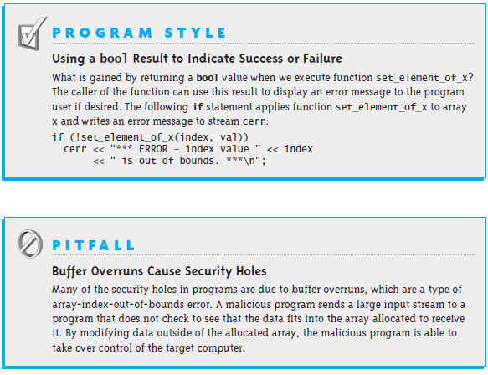
Array Index Out of Bounds (cont.)

Slide 23
Null Pointer
If you attempt to dereference a null pointer, the operating system generally will issue an error message and terminate the program
Under Windows you will see a dialog box similar to this:
Under Linux, the typical message is:
Segmentation fault
Avoid this error by ensuring pointers are not null before dereferencing them

Slide 24
Null Pointer (cont.)
The following code will generate a run-time error
double *p = NULL;
*p = 15.5;
Avoid this error by resetting p to reference a memory cell that can be used to store a double type
double *p = NULL;
p = new double;
*p = 15.5;

Slide 25
Logic Errors
A logic error occurs when the programmer or analyst
makes a mistake in the design of a class
makes a mistake in the design of a class function
has implemented an algorithm incorrectly
uses an incorrect algorithm
The C++ code will compile and run, but will not meet the specifications—it will produce incorrect results
Most logic errors do not cause syntax or run-time errors and, consequently, are difficult to find

Slide 26
Logic Errors (cont.)
Test cases can help find logic errors
Test cases allow the programmer to compare actual program output with the expected results
Software professionals must be diligent in detecting and correcting logic errors

Slide 27
Logic Errors (cont.)
The original Mars Lander spacecraft crashed because of inconsistent calculations (feet versus meters)
Billing programs have sent out bills for exorbitant amounts of money
ATM programs and off-track betting programs have caused machine owners to lose significant amounts of money
Many popular operating systems have been released with bugs that have allowed hackers to access computers easily and illicitly
A popular word processor when integrated with a document management system "ate" documents off the server leaving an empty file
In the 1980s several patients died after software controlling therapeutic radiation machines gave them massive overdoses
In August 2004, two automobile recalls that could have led to fatal accidents occurred because of software errors in control systems

Slide 28
Exceptions
Section 2.2

Slide 29
Ways to Indicate an Error
Examples of ways to indicate an error:
Return a special value
Use a bool return value to indicate success or failure
Set a global variable
Print an error message
Print an error message and exit the program
Put an input or output stream in a fail state
The first three options allow the user of a function to respond to the error

Slide 30
Ways to Indicate an Error (cont.)
int value = get_element_of_x(i);
if (value > numeric_limits<int>::min()) {
// do something with value
...
} else {
// recover from the error
...
}
// continue normal processing
If index is in bounds, function get_element_of_x(int index) returns the value of array element x[index]; else it returns number_limits<int>::min() (defined in <limits>)
This option works if there is only one possible error (in this case, an array-out-of-bounds error)

Slide 31
Ways to Indicate an Error (cont.)
An alternate way to indicate an error, especially if there are several possible errors, is through the use of exceptions
Exceptions are used to signal that an error has occurred
You can insert code in your program that throws an exception when a particular kind of error occurs
When an exception is thrown, the normal flow of execution is interrupted
An exception handler allows the user to catch or handle the exception
If there is no exception handler, then the program terminates

Slide 32
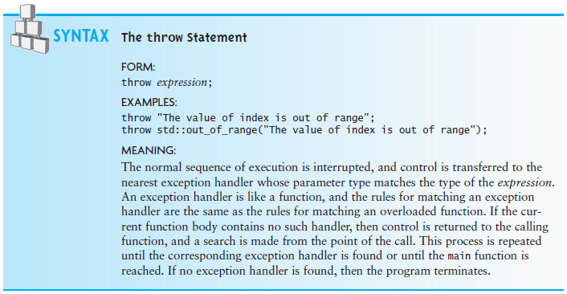
The throw Statement

Slide 33
The throw Statement (cont.)
int get_element_of_x(int index) {
if (index < 0 || index >= X_SIZE) {
throw std::out_of_range(
"In get_element_of_x, the value of index is out of range");
}
return x[index];
}
The exception object can be of any type—for example, a string literal (of type const char*) or a class instance (std::out_of_range)
The standard library includes classes that can be used to indicate exceptions
For this type of exception, control is passed to the exception handler if one is available

Slide 34
Uncaught Exceptions
When an exception occurs and is not caught, the program stops and an error message is displayed
The error message is compiler and operating system dependent and is generally not very informative
The g++ compiler under Linux gives this message:
aborted
The Microsoft .NET C++ compiler gives this message:
This application has requested the Runtime to terminate it in an unusual way.
Please contact the application's support team for more information.

Slide 35
Catching and Handling Exceptions with try and catch Blocks
To avoid uncaught exceptions you write a try block that can throw an exception and follow it with a catch block that catches the exception and handles it
try {
val = get_element_of_x(10);
}
catch (std::out_of_range& ex) {
std::cerr << "Out of range exception occurred\n";
std::cerr << ex.what() << endl;
std::abort();
}

Slide 36
Catching and Handling Exceptions with try and catch Blocks (cont.)
To avoid uncaught exceptions you write a try block that can throw an exception and follow it with a catch block that catches the exception and handles it
try {
val = get_element_of_x(10);
}
catch (std::out_of_range& ex) {
std::cerr << "Out of range exception occurred\n";
std::cerr << ex.what() << endl;
std::abort();
}
If all statements in the try block execute without error, the exception handler (the catch block) is skipped

Slide 37
Catching and Handling Exceptions with try and catch Blocks (cont.)
To avoid uncaught exceptions you write a try block that can throw an exception and follow it with a catch block that catches the exception and handles it
try {
val = get_element_of_x(10);
}
catch (std::out_of_range& ex) {
std::cerr << "Out of range exception occurred\n";
std::cerr << ex.what() << endl;
std::abort();
}
If an out_of_range exception is thrown, the exception handler executes

Slide 38
Catching and Handling Exceptions with try and catch Blocks (cont.)
To avoid uncaught exceptions you write a try block that can throw an exception and follow it with a catch block that catches the exception and handles it
try {
val = get_element_of_x(10);
}
catch (std::out_of_range& ex) {
std::cerr << "Out of range exception occurred\n";
std::cerr << ex.what() << endl;
std::abort();
}
The heading for the catch block is similar to a function declaration. The parameter, ex, has the type std::out_of_range

Slide 39
Catching and Handling Exceptions with try and catch Blocks
To avoid uncaught exceptions you write a try block that can throw an exception and follow it with a catch block that catches the exception and handles it
try {
val = get_element_of_x(10);
}
catch (std::out_of_range& ex) {
std::cerr << "Out of range exception occurred\n";
std::cerr << ex.what() << endl;
std::abort();
}
The exception handler simply displays an error message and then exits with an error indication

Slide 40
Catching and Handling Exceptions with try and catch Blocks (cont.)
To avoid uncaught exceptions you write a try block that can throw an exception and follow it with a catch block that catches the exception and handles it
try {
val = get_element_of_x(10);
}
catch (std::out_of_range& ex) {
std::cerr << "Out of range exception occurred\n";
std::cerr << ex.what() << endl;
std::abort();
}
This line passes to the standard error stream (cerr) the string passed to object ex when it was thrown by get_element_of_x

Slide 41
Catching and Handling Exceptions with try and catch Blocks (cont.)
The exception object is actually thrown (created) inside the function get_element_of_x but is handled by the catch block in the caller of get_element_of_x
To avoid uncaught exceptions you write a try block that can throw an exception and follow it with a catch block that catches the exception and handles it
try {
val = get_element_of_x(10);
}
catch (std::out_of_range& ex) {
std::cerr << "Out of range exception occurred\n";
std::cerr << ex.what() << endl;
std::abort();
}

Slide 42
Catching and Handling Exceptions with try and catch Blocks (cont.)
More than one catch block can follow a try block
Each catch block handles a different kind of exception
They are checked in the order in which they appear
try {
code that may throw an exception
}
catch (type-1 parameter-1) {
statements to process type-1
}
…
catch (type-n parameter-n) {
statements to process type-n
}

Slide 43
Catching and Handling Exceptions with try and catch Blocks (cont.)
Although in our example, the catch block handles the exception, it basically duplicates the default behavior for uncaught exceptions with a slightly more informative error message
Next, we will learn how to use the catch block to recover from errors and continue execution of a program

Slide 44
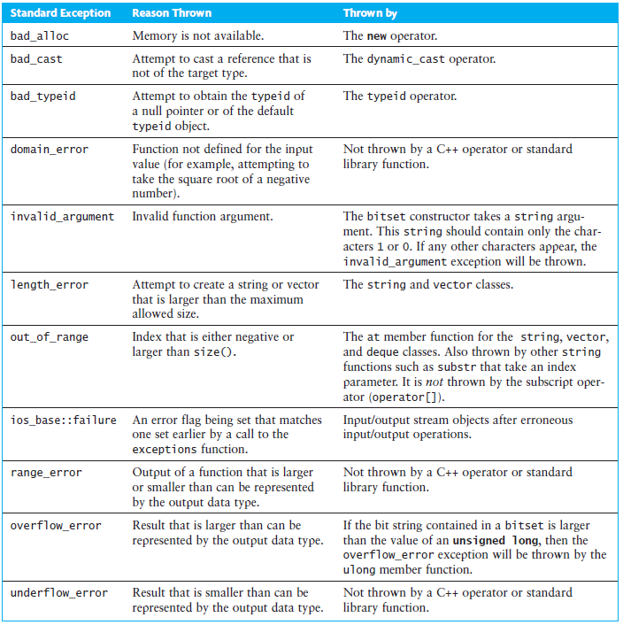
Standard Exceptions

Slide 45
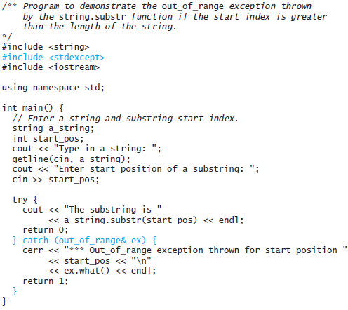
Standard Exceptions (cont.)

Slide 46
Standard Exceptions (cont.)
Sample dialogues
Type in a string: unnecessary roughness
Enter start position of a substring: 2
The substring is necessary roughness
Type in a string: unnecessary roughness
Enter start position of a substring: 30
*** Out_of_range exception thrown for start position 30
basic_string::substr

Slide 47
Handling Exceptions to Recover from Errors
A common source of errors is user input
Instead of aborting, we can recover from the error
We can use the following sequence:
if (cin >> i) {
// input of i was successful – process i
} else {
// problem reading i – attempt to recover
}
However, this requires us to test the state of cin after each input operation

Slide 48
Handling Exceptions to Recover from Errors (cont.)
Another approach is to have the istream object throw the exception std::iosbase::failure when an input error occurs
To do so, we call the istream member function exceptions and pass it the error flags that will cause an exception to be thrown
The following causes the istream cin to throw the ios_base::failure exception:
cin.exceptions(iosbase::failbit);

Slide 49
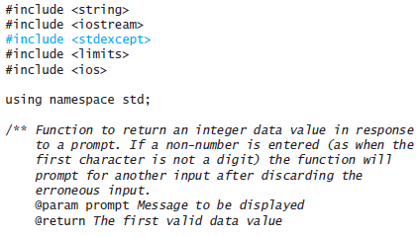
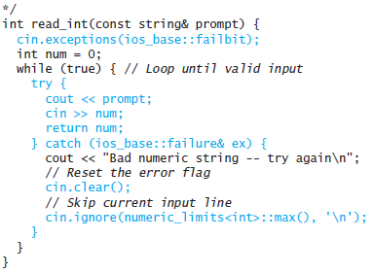
Handling Exceptions to Recover from Errors (cont.)

Slide 50
The Exception Class Hierarchy
The standard exceptions classes listed in the preceding table all are derived from the class exception which has a member function named what
All exception classes have a constructor that takes a C-string argument
The value of this argument can be retrieved by calling member function what

Slide 51
The Exception Class Hierarchy (cont.)
std:ios_base::failure is a class derived from std::exception
The two handlers in the code below must appear in the sequence shown to avoid a warning message
try {
age = read_int("Enter your age: ");
} catch (std::ios_base::failure& f) {
cerr << "Invalid number format input\n";
age = DEFAULT_AGE;
} catch (std::exception& ex) {
cerr << "Fatal error occurred in read_int\n";
cerr << ex.what() << endl;
abort();
}

Slide 52
Catching All Exceptions
Although all exceptions should be derived from the std:exception class, there is no guarantee —exceptions may be of any type
Even though we include an exception handler for std:exception we might still have an uncaught exception
C++ allows us to catch all exceptions by using ... as the exception handler parameter
Unfortunately, C++ does not provide a way to determine what exception was caught by the ... parameter

Slide 53
Catching All Exceptions (cont.)
try {
age = read_int("Enter your age: ");
} catch (std::ios_base::failure& f) {
cerr << "Invalid number format input\n";
age = DEFAULT_AGE;
} catch (std::exception& ex) {
cerr << "Fatal error occurred in read_int\n";
cerr << ex.what() << endl;
abort();
} catch (...) {
cerr << "Undefined exception occurred in read_int\n";
abort();
}

Slide 54
Testing Programs
Section 2.3

Slide 55
Testing Programs
Even after all syntax and run-time errors are removed and a program executes through to normal completion, there is a possibly that undetected logic errors exist
The "best" kind of logic error is one that occurs in an area of the program that always runs
The "worst" kind is in an obscure part of the code that is executed infrequently

Slide 56
Structured Walkthroughs
Most logic errors surface during the design phase and are the result of incorrect algorithms
Some may result from typographical errors that do not cause syntax or run-time errors
Checking the algorithm carefully before implementing it helps avoid logic errors
After implementation, we can hand-trace the algorithm, carefully simulate the execution of each step, and then compare its result to the execution result

Slide 57
Structured Walkthroughs (cont.)
A structured walkthrough is when a designer explains the algorithm or program to other team members and simulates its execution with other team members looking on
Structured walkthroughs help avoid having the designer overlook a problem because he or she over-anticipates what the steps should do

Slide 58
Levels and Types of Testing
Testing is the process of exercising a program (or part of a program) under controlled conditions and verifying that the results are as expected
The more thorough the testing, the greater the likelihood that any defects will be found
Because the number of test cases required to test all possible inputs and states in which each function in a complex program may execute can be prohibitively large, it is impossible to guarantee the absence of all defects in such a program

Slide 59
Levels and Types of Testing (cont.)
Testing usually is done at the following levels:
Unit Testing –the smallest testable piece of software; in object oriented design, this will be either a function or a class
Integration testing—testing the interactions among units; this may involve testing interactions among functions in a class but generally involves testing interactions among several classes
System testing—testing the whole program in the context in which it will be used; a program is generally part of a collection of other programs and hardware called a system; sometimes a program will work correctly until some other software is loaded onto the system
Acceptance testing—system testing designed to show that the program meets its functional requirements; this generally involves the use of the system in the real environment or as close to the real environment as possible

Slide 60
Levels and Types of Testing (cont.)
There are two types of testing:
Black-box testing
also called closed-box testing or functional testing
tests the item (function, class, or program) based on its interfaces and functional requirements
input parameters are varied over their allowed range and the results are compared against independently calculated results
input parameters outside the allowed range are tested to ensure that the function responds as specified
the value of data fields and any global variables can also be used in testing

Slide 61
Levels and Types of Testing (cont.)
White-box testing
Also called glass-box testing, open-box testing, and coverage testing
Tests the software element (function, class, or program) using knowledge of its internal structure
The goal is to exercise as many of the possible paths through the element as is practical

Slide 62
Levels and Types of Testing (cont.)
White-box testing
There are various degrees of coverage:
Statement coverage—the simplest; ensures that each statement is executed at least one
Branch coverage—ensures that each choice of each branch (if and switch statements and loops) is taken
For example, all if statements must be tested with true and false conditions
Path coverage—tests each path through a function
If there are n if statements and the if statements are not nested, each condition has two possible values, so there could be 2^{n} possible paths, so full path coverage could require 2^{n} test cases

Slide 63
Levels and Types of Testing (cont.)
void test_function(char a, char b){
if (a < 'M') {
if (b < 'X') {
cout << "Path 1\n";
} else {
cout << "Path 2\n";
}
} else {
if (b < 'C') {
cout << "Path 3\n";
} else {
cout << "Path 4\n";
}
}
}
To test this function, we pass it argument values that cause it to follow each of the different paths

Slide 64
Levels and Types of Testing (cont.)
void test_function(char a, char b){
if (a < 'M') {
if (b < 'X') {
cout << "Path 1\n";
} else {
cout << "Path 2\n";
}
} else {
if (b < 'C') {
cout << "Path 3\n";
} else {
cout << "Path 4\n";
}
}
}
a | b | Message
'A' | 'A' | Path 1
'A' | 'Z' | Path 2
'Z' | 'A' | Path 3
'Z' | 'Z' | Path 4

Slide 65
Levels and Types of Testing (cont.)
void test_function(char a, char b){
if (a < 'M') {
if (b < 'X') {
cout << "Path 1\n";
} else {
cout << "Path 2\n";
}
} else {
if (b < 'C') {
cout << "Path 3\n";
} else {
cout << "Path 4\n";
}
}
}
a | b | Message
'A' | 'A' | Path 1
'A' | 'Z' | Path 2
'Z' | 'A' | Path 3
'Z' | 'Z' | Path 4
The values for a and b in the table above are the smallest and largest uppercase letters (For a more thorough test, we should see what happens when a and b are passed values that are between A and Z)

Slide 66
Levels and Types of Testing (cont.)
void test_function(char a, char b){
if (a < 'M') {
if (b < 'X') {
cout << "Path 1\n";
} else {
cout << "Path 2\n";
}
} else {
if (b < 'C') {
cout << "Path 3\n";
} else {
cout << "Path 4\n";
}
}
}
Also, what happens when a and b are not uppercase letters?
What message would be displayed if:
a and b are both '2'
a and b are both lowercase letters
a is a digit and b is a lowercase letter

Slide 67
Levels and Types of Testing (cont.)
void test_function(char a, char b){
if (a < 'M') {
if (b < 'X') {
cout << "Path 1\n";
} else {
cout << "Path 2\n";
}
} else {
if (b < 'C') {
cout << "Path 3\n";
} else {
cout << "Path 4\n";
}
}
}
As you can see, the number of test cases required to thoroughly test even a simple function like test_function can become quite large

Slide 68
Preparations for Testing
The earlier an error is detected, the easier and less expensive it is to correct it
A test plan should be developed early in the design stage
Some aspects of the test plan should include
deciding how the software will be tested
when the tests will occur
who will do the testing
what test data will be used
If the test plan is developed early in the design stage, testing can take place concurrently with the design and coding

Slide 69
Preparations for Testing (cont.)
Deciding on a test plan early encourages programmers to practice defensive programming—preparing for testing by including code that detects unexpected or invalid data values
For example, if a function has the precondition:
pre: n greater than zero
we can place the assert statement
assert (n > 0);
at the beginning of the function
The assert macro will provide a diagnostic message and terminate the program in the event that the argument passed to the function is invalid

Slide 70
Preparations for Testing (cont.)
If a data value being read from the keyboard is supposed to be between 0 and 40, a defensive programmer might read this value by creating a modified version of the read_int function:
int read_int(string prompt, int low, int high) {...}
The first parameter is the prompt string, the second the lower limit, the third the upper limit
If an integer is read without error the revised function would verify that this value was in the range low to high before returning it
If not, the user would be asked to enter a new number
Here is a sample function call:
hours = read_int("Enter number of hours worked ", 0, 40);

Slide 71
Testing Tips for Program Systems
You should plan for testing as you write each module rather than after the fact
Here is a list of 5 testing tips to follow when writing class functions:
If the function implements an interface, the interface specification should document the input parameters and the expected results
Document each function parameter and class attribute carefully, using comments as you write the code. Also describe the function operation using documentation comments following conventions discussed in Section 1.3

Slide 72
Testing Tips for Program Systems (cont.)
Leave a trace of execution by displaying the function name as you enter it
Display the values of all input parameters upon entry to a function. Also display the values of any class attributes that are accessed by this function; check that these values make sense
Display the values of all function outputs after returning from a function
By hand computation, verify that these values are correct

Slide 73
Testing Tips for Program Systems (cont.)
Include output statements for Steps 2 through 4 in the function code
static const bool TESTING = true;
...
if (TESTING) {
// testing output code
}
Different bool flags may be used for different kinds of tests

Slide 74
Developing the Test Data
The test data should be specified during the analysis and design phases at each level: unit, integration, and system
In black-box testing, we:
focus on the relationship between the unit inputs and outputs
check all expected classes of inputs
check for unanticipated data
develop a test plan to specify the expected unit behavior and output for each set of input data

Slide 75
Developing the Test Data (cont.)
In white-box testing, we:
focus on exercising alternative paths through the code
design test data to ensure that all if statement conditions will evaluate to both true and false
test different combinations of true and false in nested if statements
make sure that the selector variables for switch statements can take on all values listed as case labels and some that are not
verify, for loops, that the result is correct if
an immediate exit occurs (zero repetitions)
only one iteration is performed
the maximum number of iterations is performed
and verify that loop repetition can always terminate

Slide 76
Testing Boundary Conditions
for (int i = 0; i < x_length; i++) {
if (x[i] == target)
return i;
}
Here is a list of boundary conditions to test for in the code above
The target element is the first array element (x[0] == target is true)
The target element is only in the last array element (x[x_length – 1] == target is true)
The target element is not in the array (x[i] == target is always false)
There are multiple occurrences of the target element (x[i] == target is true for more than one value of i)
The target element is somewhere in the middle of the array
The array has only one element
The array has no elements

Slide 77
Testing Boundary Conditions
The first four cases test the boundary conditions for the loop and would be required in white-box testing (but also should be tested in black-box testing)
for (int i = 0; i < x_length; i++) {
if (x[i] == target)
return i;
}
Here is a list of boundary conditions to test for in the code above
The target element is the first array element (x[0] == target is true)
The target element is only in the last array element (x[x_length – 1] == target is true)
The target element is not in the array (x[i] == target is always false)
There are multiple occurrences of the target element (x[i] == target is true for more than one value of i)
The target element is somewhere in the middle of the array
The array has only one element
The array has no elements

Slide 78
Testing Boundary Conditions
for (int i = 0; i < x_length; i++) {
if (x[i] == target)
return i;
}
Here is a list of boundary conditions to test for in the code above
The target element is the first array element (x[0] == target is true)
The target element is only in the last array element (x[x_length – 1] == target is true)
The target element is not in the array (x[i] == target is always false)
There are multiple occurrences of the target element (x[i] == target is true for more than one value of i)
The target element is somewhere in the middle of the array
The array has only one element
The array has no elements
The next case is not a boundary case, but is a typical situation that also should be tested in either white-box or black-box testing

Slide 79
Testing Boundary Conditions
for (int i = 0; i < x_length; i++) {
if (x[i] == target)
return i;
}
Here is a list of boundary conditions to test for in the code above
The target element is the first array element (x[0] == target is true)
The target element is only in the last array element (x[x_length – 1] == target is true)
The target element is not in the array (x[i] == target is always false)
There are multiple occurrences of the target element (x[i] == target is true for more than one value of i)
The target element is somewhere in the middle of the array
The array has only one element
The array has no elements
Boundary conditions for an array search should be tested in either white-box or block-box testing

Slide 80
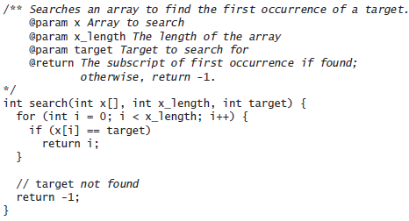
Testing Boundary Conditions (cont.)

Slide 81
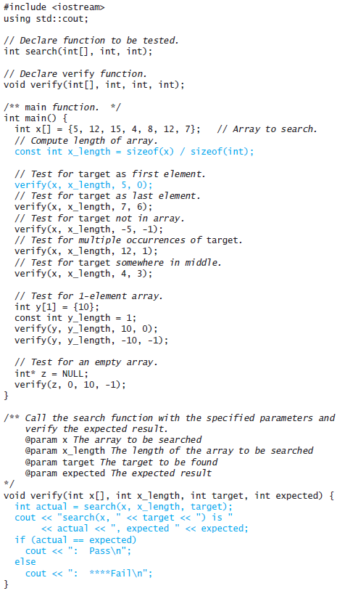
Testing Boundary Conditions (cont.)

Slide 82
Testing Boundary Conditions (cont.)

Slide 83
Who Does the Testing?
Testing is done by:
the programmer
other members of the software team who did not code the module being tested
the final users of the software product
It is extremely important not to rely only on the programmer who coded a module to test it because programmers often are blind to their own oversights
Involving future users helps determine whether they have difficulty interpreting prompts for data (since they are typically less knowledgeable about programming)

Slide 84
Who Does the Testing? (cont.)
Companies often have quality assurance (QA) organizations that verify that the testing process is performed correctly
Generally the programmer who wrote the unit does unit testing while a separate test team does integration testing and system testing
One methodology, called Extreme Programming, puts programmers in pairs; one writes the code, the other writes the tests. The tester also observes the coder while the code is being written. They take turns so that each team member is involved in both coding and testing

Slide 85
Stubs
The substitute for a function that has not yet been implemented or tested is called a stub
Stubs are useful in testing when not all functions and classes are completed at the same time
A stub has the same header as the function it replaces, but its body merely displays a message indicating that the stub was called
A stub can also display values of inputs and assign predictable values to any outputs or predictably change the state of a data field (if required)

Slide 86
Stubs (cont.)
/** Function to save the directory.
pre: The directory has been loaded with data.
post: The directory contents have been written back to the file as name- number pairs on adjacent lines. modified is reset to false
*/
void save() {
cout << "Stub for save has been called\n";
modified = false;
}

Slide 87
Drivers
A driver program
Declares any necessary object instances and variables
Assigns values to any of the function's inputs (as specified in the function's preconditions)
Calls the function
Displays the values of any outputs returned by the function
The previous listing was a driver program to test function search

Slide 88
Testing a Class
Recall the Directory_Entry class from Section 1.6
The main function of this class could be a test driver
We could write test cases to verify that the constructor and the functions get_name and get_number perform correctly

Slide 89
Test Framework
A test case is an individual test
A collection of test cases is known as a test suite
A program that executes a series of tests and reports the results is known as a test harness
A test framework is a software product that facilitates writing test cases, organizing the test cases into test suites, running the test suites, and reporting the results
One open-source test framework for C++ projects that can be used in a stand-alone mode is CppUnit

Slide 90
Regression Testing
We should save our test plan, test suite (stubs and drivers), and test results
Whenever a change is made to a function, class, or program, the tests can (and should) be rerun to determine that the change did not cause an unintended consequence
The rerunning of tests and verifying that nothing changed is called regression testing

Slide 91
Integration Testing
In integration testing the program tester determines if the individual components of the system, which have been tested separately, can be integrated with other components
Each phase of integration testing deals with larger components, progressing from individual units, such as functions or classes, and ending with the entire system
Once the entire system is completed, integration testing determines whether that system is compatible with other systems in the computing environment in which it will be used
If we have prepared UML diagrams as system documentation, we can use these diagrams to determine the expected interaction between units in our program system

Slide 92
Debugging a Program
Section 2.4

Slide 93
Debugging a Program
Debugging, the process of removing errors, is a major activity performed during the testing process
Testing determines whether you have an error; debugging determines the cause of (and means of correcting) an error (run-time and logic)
During debugging, we might trace through a function or we might insert additional diagnostic statements in the function

Slide 94
Debugging a Program (cont.)
The function read_int
...
/** Function to return an integer data value between two
specified end points.
pre: min_n <= max_n
@param prompt Message to be displayed
@param min_n Smallest value in range
@param max_n Largest value in range
@throws invalid_argument if min_n > max_n
@return The first data value that is in the range
*/
int read_int(const string& prompt, int min_n, int max_n) {

Slide 95
Debugging a Program (cont.)
int read_int(const string& prompt, int min_n, int max_n) {
if (min_n > max_n)
throw invalid_argument("In read_int, min_n not <= max_n");
bool in_range = false;
int num = 0;
while (!in_range) {
cout << prompt;
if (cin >> num) {
in_range = min_n <= num <= max_n;
} else {
cout << "Bad numeric string – try again\n";
//reset the error flag
cin.clear();
// Skip current input line
cin.ignore(number_limits<int>::max(), '\n');
}
}
return num;
}

Slide 96
Debugging a Program (cont.)
int read_int(const string& prompt, int min_n, int max_n) {
if (min_n > max_n)
throw invalid_argument("In read_int, min_n not <= max_n");
bool in_range = false;
int num = 0;
while (!in_range) {
cout << prompt;
if (cin >> num) {
in_range = min_n <= num <= max_n;
} else {
cout << "Bad numeric string – try again\n";
//reset the error flag
cin.clear();
// Skip current input line
cin.ignore(number_limits<int>::max(), '\n');
}
}
return num;
}
This function does not seem to recognize that a value is outside of the specified range. Instead it appears to accept any input value

Slide 97
Debugging a Program (cont.)
int read_int(const string& prompt, int min_n, int max_n) {
if (min_n > max_n)
throw invalid_argument("In read_int, min_n not <= max_n");
bool in_range = false;
int num = 0;
while (!in_range) {
cout << prompt;
if (cin >> num) {
in_range = min_n <= num <= max_n;
} else {
cout << "Bad numeric string – try again\n";
//reset the error flag
cin.clear();
// Skip current input line
cin.ignore(number_limits<int>::max(), '\n');
}
}
return num;
}
This statement appears not to be working

Slide 98
Debugging a Program (cont.)
int read_int(const string& prompt, int min_n, int max_n) {
if (min_n > max_n)
throw invalid_argument("In read_int, min_n not <= max_n");
bool in_range = false;
int num = 0;
while (!in_range) {
cout << prompt;
if (cin >> num) {
in_range = min_n <= num <= max_n;
cout << "min_n:" << min_n << " max_n:" << max_n << " num:" << num << " in_range:" << in_range << '\n';
} else {
cout << "Bad numeric string – try again\n";
//reset the error flag
cin.clear();
// Skip current input line
cin.ignore(number_limits<int>::max(), '\n');
…
Insert a diagnostic statement to view the values of the variables

Slide 99
Debugging a Program (cont.)
int read_int(const string& prompt, int min_n, int max_n) {
if (min_n > max_n)
throw invalid_argument("In read_int, min_n not <= max_n");
bool in_range = false;
int num = 0;
while (!in_range) {
cout << prompt;
if (cin >> num) {
in_range = min_n <= num <= max_n;
cout << "min_n:" << min_n << " max_n:" << max_n << " num:" << num << " in_range:" << in_range << '\n';
} else {
cout << "Bad numeric string – try again\n";
//reset the error flag
cin.clear();
// Skip current input line
cin.ignore(number_limits<int>::max(), '\n');
…
When run, min_n, max_n, and num will all have expected values but in_range will not be correct

Slide 100
Debugging a Program (cont.)
int read_int(const string& prompt, int min_n, int max_n) {
if (min_n > max_n)
throw invalid_argument("In read_int, min_n not <= max_n");
bool in_range = false;
int num = 0;
while (!in_range) {
cout << prompt;
if (cin >> num) {
in_range = min_n <= num <= max_n;
cout << "min_n:" << min_n << " max_n:" << max_n << " num:" << num << " in_range:" << in_range << '\n';
} else {
cout << "Bad numeric string – try again\n";
//reset the error flag
cin.clear();
// Skip current input line
cin.ignore(number_limits<int>::max(), '\n');
…
The problem occurs in this statement

Slide 101
Debugging a Program (cont.)
int read_int(const string& prompt, int min_n, int max_n) {
if (min_n > max_n)
throw invalid_argument("In read_int, min_n not <= max_n");
bool in_range = false;
int num = 0;
while (!in_range) {
cout << prompt;
if (cin >> num) {
in_range = min_n <= num <= max_n;
cout << "min_n:" << min_n << " max_n:" << max_n << " num:" << num << " in_range:" << in_range << '\n';
} else {
cout << "Bad numeric string – try again\n";
//reset the error flag
cin.clear();
// Skip current input line
cin.ignore(number_limits<int>::max(), '\n');
…
min_n <= num
is evaluated first. The result is a bool value

Slide 102
Debugging a Program (cont.)
int read_int(const string& prompt, int min_n, int max_n) {
if (min_n > max_n)
throw invalid_argument("In read_int, min_n not <= max_n");
bool in_range = false;
int num = 0;
while (!in_range) {
cout << prompt;
if (cin >> num) {
in_range = min_n <= num <= max_n;
cout << "min_n:" << min_n << " max_n:" << max_n << " num:" << num << " in_range:" << in_range << '\n';
} else {
cout << "Bad numeric string – try again\n";
//reset the error flag
cin.clear();
// Skip current input line
cin.ignore(number_limits<int>::max(), '\n');
…
The resulting bool value is converted to an int value, 0 for false and 1 for true and then compared to max_n. If max_n is greater than or equal to 1, the expression is always true

Slide 103
Debugging a Program (cont.)
int read_int(const string& prompt, int min_n, int max_n) {
if (min_n > max_n)
throw invalid_argument("In read_int, min_n not <= max_n");
bool in_range = false;
int num = 0;
while (!in_range) {
cout << prompt;
if (cin >> num) {
in_range = min_n <= num && num <= max_n;
cout << "min_n:" << min_n << " max_n:" << max_n << " num:" << num << " in_range:" << in_range << '\n';
} else {
cout << "Bad numeric string – try again\n";
//reset the error flag
cin.clear();
// Skip current input line
cin.ignore(number_limits<int>::max(), '\n');
…
To solve this, we need to change the statement to this

Slide 104
Using a Debugger
Single-step execution involves executing a statement in increments as small as one program statement; examining the contents of variables at each step
As an alternative, setting breakpoints allows us to divide your program into sections. The debugger executes until it encounters a breakpoint
When our program pauses, if the next statement is a call to a function, we can select single-step execution in the function, called step into
Or we can execute all the function statements as a group and pause after the return from the function, called step over
Although the process is similar among IDEs, the actual mechanics of using a debugger depend on the specific IDE that we are using

Slide 105
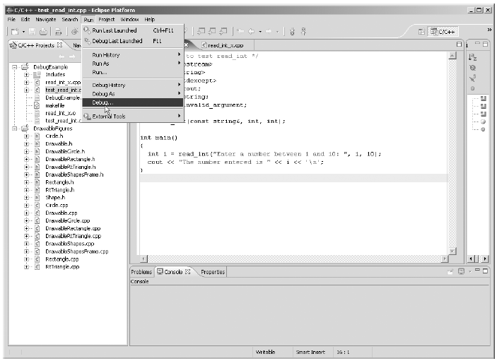
Starting the Debugger in Eclipse

Slide 106
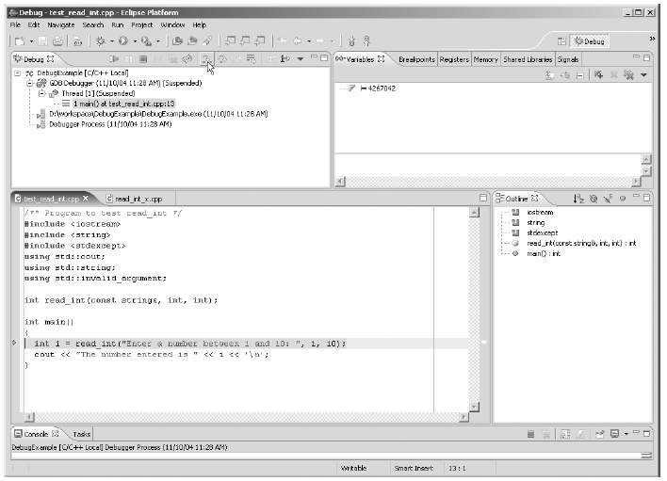
Using the Debugger in Eclipse

Slide 107
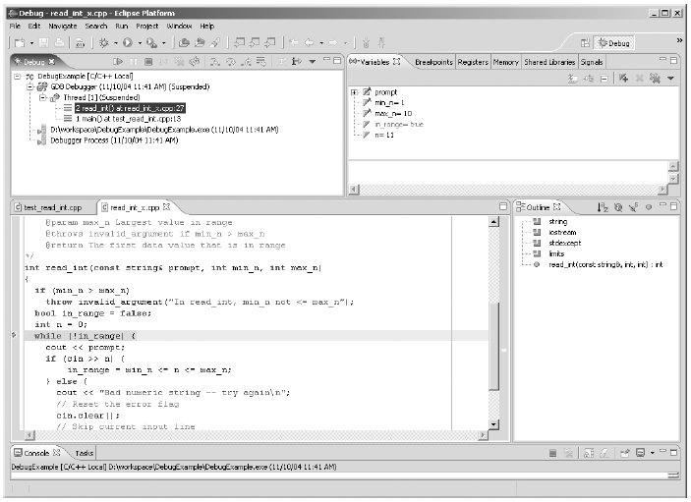
The Editor and Debugger Windows in Eclipse

Slide 108
Reasoning about Programs: Assertions and Loop Invariants
Section 2.5

Slide 109
Reasoning about Programs: Assertions and Loop Invariants
Formal verification of programs is an area of active research in computer science
Formal verification involves the use of tools to prove that a function or program is correct
While it is desirable to prove the correctness of a program, we usually cannot do this
In practice, formal verification is used more as a documentation tool (and to enable a programmer to reason about a program)
In this section we explore two concepts: assertions and loop invariants

Slide 110
Assertions
Assertions are logical statements about a program that are "asserted" to be true
Assertions generally are written as comments in the program
Preconditions and postconditions are assertion statements
A precondition is an assertion about the state of the program (generally the input parameters) before a function is executed
A postcondition is an assertion about the state when the function finishes

Slide 111
Assertions (cont.)
Example
int search (int x[], int x_length, int target) {
for (int i = 0; i < x_length; i++) {
if (x[i] == target)
return i;
}
//assert: all elements were tested and target not found
return -1;
}

Slide 112
Loop Invariants
Loops are a common source of program errors
It can be difficult to determine that
a loop body executes exactly the right number of times
loop execution causes the desired change in program variables
Programmers can use a special type of assertion, called a loop invariant, to help prove that a loop meets its specification

Slide 113
Loop Invariants (cont.)
A loop invariant is a Boolean expression that is true
before loop execution begins
at the beginning of each repetition of the loop body
just after loop exit
It is called an invariant because it is a relationship that remains true at all times as loop execution progresses
If we can
determine the loop invariant for the process that we want a loop to perform
and then verify that the execution of a C++ loop preserves the invariant,
then we can be confident that the C++ loop is correct

Slide 114
Loop Invariants (cont.)
A proposed invariant for a search loop that finds the first occurrence of a target value might be the following:
If i is the subscript of the array element we are testing in the loop
for all k, such that 0 <= k < i, x[k] != target
In other words, "For all nonnegative integer values of k less than i, the kth element of x is not equal to the target"

Slide 115
Loop Invariants (cont.)
Let's verify that this is an invariant:
The invariant must be true before loop execution begins
Before loop execution begins, i would be 0 and these is no nonnegative integer less than 0, so there are no possible values of k and thus no value of k such that x[k] is equal to target, so the invariant must be true before loop execution begins

Slide 116
Loop Invariants (cont.)
Let's verify that this is an invariant:
The invariant must be true at that beginning of each repetition of the loop
During loop repetition, we compare x[i] to the target and exit the loop if the target is found. However, if x[k] is equal to target for a value of k < i, we have found the target already, exited the loop, and not started the present repetition, so the invariant must be true at the beginning of each repetition of the loop

Slide 117
Loop Invariants (cont.)
Let's verify that this is an invariant:
The invariant must be true after loop exit
We exit the loop after testing all array elements and finding that x[k] != target for all k < x_length, so the invariant must be true after loop exit
Now that we have the invariant, we write a loop that preserves it...

Slide 118
Loop Invariants (cont.)
int i = 0;
// invariant: for all k, such that 0 <= k < i, x[k] != target
while (i < x_length) {
if (x[i] == target)
return i; // target found at i
i++; // test next element
}
// assert: for all k, such that 0 <= k < i, x[k] != target
// and i >= x_length
return -1; // target not found

Slide 119
Loop Invariants (cont.)
int i = 0;
// invariant: for all k, such that 0 <= k < i, x[k] != target
while (i < x_length) {
if (x[i] == target)
return i; // target found at i
i++; // test next element
}
// assert: for all k, such that 0 <= k < i, x[k] != target
// and i >= x_length
return -1; // target not found
Let's show that this loop preserves the invariant

Slide 120
Loop Invariants (cont.)
int i = 0;
// invariant: for all k, such that 0 <= k < i, x[k] != target
while (i < x_length) {
if (x[i] == target)
return i; // target found at i
i++; // test next element
}
// assert: for all k, such that 0 <= k < i, x[k] != target
// and i >= x_length
return -1; // target not found
Variable i is initially 0, the invariant is true before the loop repetition begins

Slide 121
Loop Invariants (cont.)
int i = 0;
// invariant: for all k, such that 0 <= k < i, x[k] != target
while (i < x_length) {
if (x[i] == target)
return i; // target found at i
i++; // test next element
}
// assert: for all k, such that 0 <= k < i, x[k] != target
// and i >= x_length
return -1; // target not found
Prior to each loop repetition, the invariant must be true for the current value of i or we would have executed the return statement with a value of k less than i

Slide 122
Loop Invariants (cont.)
int i = 0;
// invariant: for all k, such that 0 <= k < i, x[k] != target
while (i < x_length) {
if (x[i] == target)
return i; // target found at i
i++; // test next element
}
// assert: for all k, such that 0 <= k < i, x[k] != target
// and i >= x_length
return -1; // target not found
Loop exit occurs only when the loop condition fails (i is x_length). Because this occurs only if we did not find the target, x[k] != target must be true for all k < x_length (the current value of i), so the loop invariant is still true

Slide 123
Loop Invariants (cont.)
int i = 0;
// invariant: for all k, such that 0 <= k < i, x[k] != target
while (i < x_length) {
if (x[i] == target)
return i; // target found at i
i++; // test next element
}
// assert: for all k, such that 0 <= k < i, x[k] != target
// and i >= x_length
return -1; // target not found
When the loop ends, the invariant is still true, but the loop repetition condition is now false

Slide 124
Loop Invariants (cont.)
int i = 0;
// invariant: for all k, such that 0 <= k < i, x[k] != target
while (i < x_length) {
if (x[i] == target)
return i; // target found at i
i++; // test next element
}
// assert: for all k, such that 0 <= k < i, x[k] != target
// and i >= x_length
return -1; // target not found
Therefore we can combine the loop invariant and the negation of the loop repetition condition to create this assertion

Slide 125
Loop Invariants (cont.)
A topic of computer science research is proving that a loop is correct by
writing an assertion that is a loop precondition
and an assertion that is a loop postcondition
and then proving that the postcondition assertion follows from the precondition assertion
This would constitute a proof that the loop is correct

Slide 126
The C++ assert Macro
Assertions written as comments are valuable for understanding a program, but the programmer must check the actual code manually
C++ provides an assert macro (defined in the header <cassert>) to give the assertion "teeth"
Generally the assert macro calls an internally defined function to print an error message and terminate the program if the asserted condition is not true
The definition of the macro varies with different implementations

Slide 127
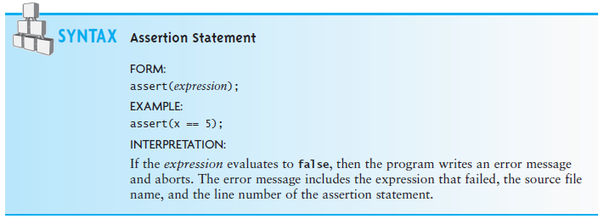
The C++ assert Macro (cont.)

Slide 128
Efficiency of Algorithms
Section 2.6

Slide 129
Efficiency of Algorithms
Getting a precise measure of the performance of an algorithm is difficult
We can try to approximate the effect of a change in the number of data items, n, that an algorithm processes
In this way we can see how an algorithm's execution time increases with respect to n, so we can compare two algorithms by examining their growth rate
For many problems there are algorithms that are relatively obvious but inefficient
Even though computers are getting faster, with larger memories, algorithm growth rates can be so large that no computer can solve the problem above a certain size

Slide 130
Efficiency of Algorithms (cont.)
Consider the following function which searches an array for a value:
int search(int x[], int x_length, int target) {
for(int i = 0; i < x_length; i++) {
if (x[i] == target)
return i;
}
return -1; // target not found
}

Slide 131
Efficiency of Algorithms (cont.)
Consider the following function which searches an array for a value:
int search(int x[], int x_length, int target) {
for(int i = 0; i < x_length; i++) {
if (x[i] == target)
return i;
}
return -1; // target not found
}
If the target is not present in the array, then the for loop will execute x_length times
If the target is present, the for loop will execute (on average) x_length/2 times
Therefore, the total execution time is directly proportional to x_length
If we double the size of the array, we expect the time to double

Slide 132
Efficiency of Algorithms (cont.)
Consider a function to determine if two arrays have no common elements (using our previous search function):
bool are_different(int x[], int x_length, int y[], int y_length) {
for(int i = 0; i < x_length; i++) {
if (search(y,y_length, x[i]) != -1)
return false;
}
return true;
}

Slide 133
Efficiency of Algorithms (cont.)
Consider a function to determine if two arrays have no common elements (using our previous search function):
bool are_different(int x[], int x_length, int y[], int y_length) {
for(int i = 0; i < x_length; i++) {
if (search(y,y_length, x[i]) != -1)
return false;
}
return true;
}
The for loop will execute x_length times
But it will call search, which will execute y_length times
The total execution time is proportional to (x_length * y_length)

Slide 134
Efficiency of Algorithms (cont.)
Consider a function that determines whether each item in an array is unique
bool are_unique(int x[], int x_length) {
for(int i=0; i < x_length; i++) {
for(int j=0; j < x_length; j++) {
if (i != j && x[i] == x[j])
return false;
}
}
return true;
}

Slide 135
Efficiency of Algorithms (cont.)
Consider a function that determines whether each item in an array is unique
bool are_unique(int x[], int x_length) {
for(int i=0; i < x_length; i++) {
for(int j=0; j < x_length; j++) {
if (i != j && x[i] == x[j])
return false;
}
}
return true;
}
If all values are unique, the for loop with i as index will execute x_length times
Inside this loop, the for loop with j as index will execute x_length times
The total number of times the loop body of the innermost loop will execute is (x.length)²

Slide 136
Efficiency of Algorithms (cont.)
The previous function was very inefficient. We do twice as many tests as is necessary. We can rewrite it as follows:
bool are_unique(int x[], int x_length) {
for(int i = 0; i < x_length; i++) {
for(int j = i + 1; j < x_length; j++) {
if (x[i] == x[j])
return false;
}
}
return true;
}

Slide 137
Efficiency of Algorithms (cont.)
The previous function was very inefficient. We do twice as many tests as is necessary. We can rewrite it as follows:
bool are_unique(int x[], int x_length) {
for(int i = 0; i < x_length; i++) {
for(int j = i + 1; j < x_length; j++) {
if (x[i] == x[j])
return false;
}
}
return true;
}
This loop will execute x_length - 1 times the first time. The second time it will execute x_length - 2 times, and so on. The last time it will execute once

Slide 138
Efficiency of Algorithms (cont.)

Slide 139
Big-O Notation
Understanding how the execution time (and memory requirements) of an algorithm grow as a function of increasing input size gives programmers a tool for comparing various algorithms and determining how they will perform
If the time is approximately doubled when the number of inputs, n, is doubled, then the algorithm grows at a linear rate or a growth rate of order n
If the time is approximately quadrupled when the number of inputs is doubled, then the algorithm grows at a quadratic rate or at a growth rate of order of n²

Slide 140
Big-O Notation (cont.)
In the previous section we looked at four functions with the following execution times related to:
x_length
x_length * y_length
(x_length)²
(x_length)² and x_length
Computer scientists use the notation
O(n) to represent the first case
O(n x m) to represent the second
O(n²) to represent the third and fourth,
where n is x_length and m is y_length
The symbol O can be thought of as an abbreviation for “order of magnitude”
This notation is called big-O notation

Slide 141
Big-O Notation (cont.)
A simple way to determine the big-O of an algorithm or program is to look at any loops and to see whether the loops are nested.
Assuming that the loop body consists only of simple statements,
a single loop is O(n)
a nested loop is O(n²)
a nested loop in a nested loop is O(n³), and so on

Slide 142
Big-O Notation (cont.)

Slide 143
Formal Definition of Big-O
Consider the following program structure:
for (int i = 0; i < n; i++) {
for (int j = 0; j < n; j++) {
Simple Statement
}
}
for (int k = 0; k < n; k++) {
Simple Statement 1
Simple Statement 2
Simple Statement 3
Simple Statement 4
Simple Statement 5
}
Simple Statement 6
Simple Statement 7
...
Simple Statement 30

Slide 144
Formal Definition of Big-O (cont.)
Consider the following program structure:
for (int i = 0; i < n; i++) {
for (int j = 0; j < n; j++) {
Simple Statement
}
}
for (int k = 0; k < n; k++) {
Simple Statement 1
Simple Statement 2
Simple Statement 3
Simple Statement 4
Simple Statement 5
}
Simple Statement 6
Simple Statement 7
...
Simple Statement 30
This nested loop executes a Simple Statement n² times

Slide 145
Formal Definition of Big-O (cont.)
Consider the following program structure:
for (int i = 0; i < n; i++) {
for (int j = 0; j < n; j++) {
Simple Statement
}
}
for (int k = 0; k < n; k++) {
Simple Statement 1
Simple Statement 2
Simple Statement 3
Simple Statement 4
Simple Statement 5
}
Simple Statement 6
Simple Statement 7
...
Simple Statement 30
This loop executes 5 Simple Statements n times (5n)

Slide 146
Formal Definition of Big-O (cont.)
Consider the following program structure:
for (int i = 0; i < n; i++) {
for (int j = 0; j < n; j++) {
Simple Statement
}
}
for (int k = 0; k < n; k++) {
Simple Statement 1
Simple Statement 2
Simple Statement 3
Simple Statement 4
Simple Statement 5
}
Simple Statement 6
Simple Statement 7
...
Simple Statement 30
Finally, 25 Simple Statements are executed

Slide 147
Formal Definition of Big-O (cont.)
Consider the following program structure:
for (int i = 0; i < n; i++) {
for (int j = 0; j < n; j++) {
Simple Statement
}
}
for (int k = 0; k < n; k++) {
Simple Statement 1
Simple Statement 2
Simple Statement 3
Simple Statement 4
Simple Statement 5
}
Simple Statement 6
Simple Statement 7
...
Simple Statement 30
We can conclude that the relationship between processing time and n (the number of date items processed) is:
T(n) = n² + 5n + 25

Slide 148
Formal Definition of Big-O (cont.)

Slide 149
Formal Definition of Big-O (cont.)
The growth rate of f(n) will be determined by the fastest growing term, which is the one with the largest exponent
In the example, an algorithm of
O(n² + 5n + 25)
is more simply expressed as
O(n²)
In general, it is safe to ignore all constants and to drop the lower-order terms when determining the order of magnitude

Slide 150
Big-O Example 1
Given T(n) = n² + 5n + 25, show that this is O(n²)
Find constants n₀ and c such that for all n > n₀, cn² > n² + 5n + 25
Find the point where cn² = n² + 5n + 25
Let n = n₀, and solve for c
c = 1 + 5/ n₀ + 25/ n₀ ²
When n₀ is 5, this gives us a c of 3
So, 3n² > n² + 5n + 25 for all n > 5

Slide 151
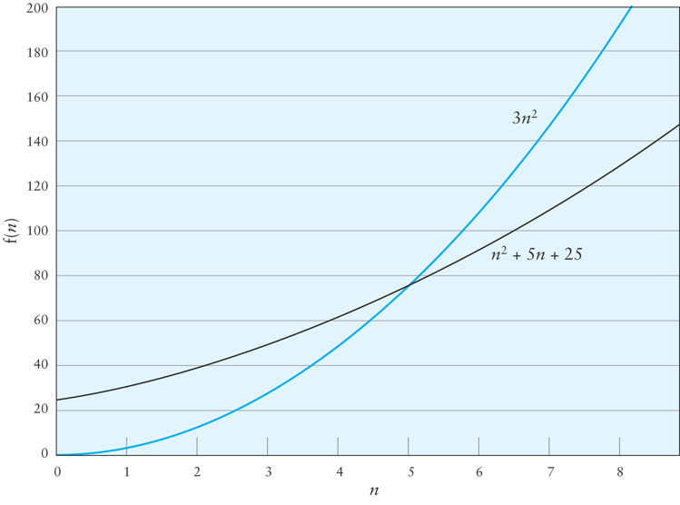
Big-O Example 1 (cont.)

Slide 152
Big-O Example 2

Slide 153
Big-O Example 2 (cont.)
reversing the order of the terms inside the parentheses,
3 (n – 1 + n – 2 + n – 3 + … + 1)
= 3 (1 + 2 + 3 + … + n – 1)
which can be expressed as
3 (n x (n – 1))/2
= 3 (n² – n)/2
= 3n²/2 – 3n/2
= 1.5n² – 1.5n

Slide 154
Big-O Example 2 (cont.)
Therefore T(n) = 1.5n² – 1.5n
When n = 0, the polynomial has the value 0
For values of n > 1, 1.5n² > 1.5n² – 1.5n
Therefore T(n) is O(n²) when n₀ is 1 and c is 1.5

Slide 155
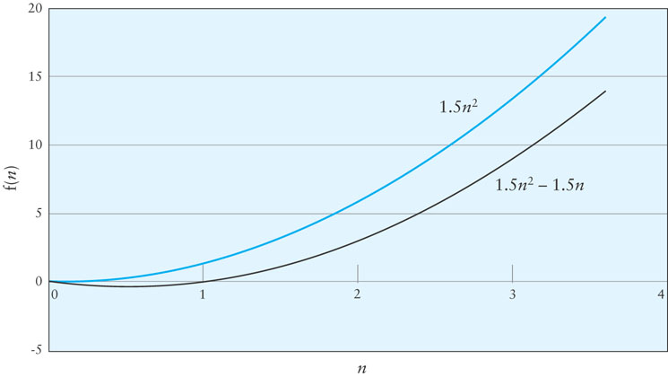
Big-O Example 2 (cont.)

Slide 156
Symbols Used in Quantifying Performance

Slide 157
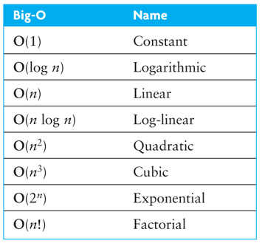
Common Growth Rates

Slide 158
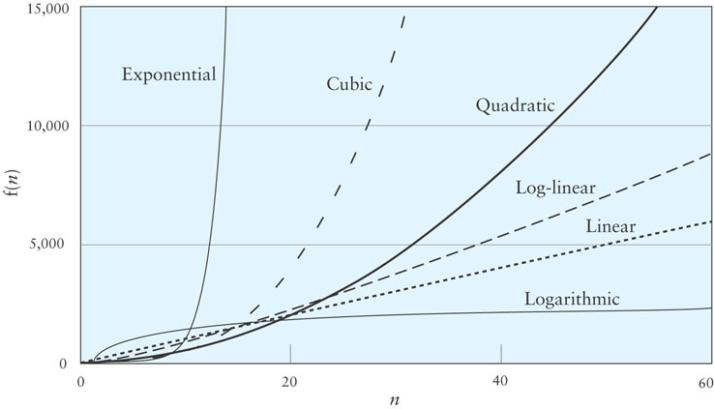
Comparing Performance

Slide 159
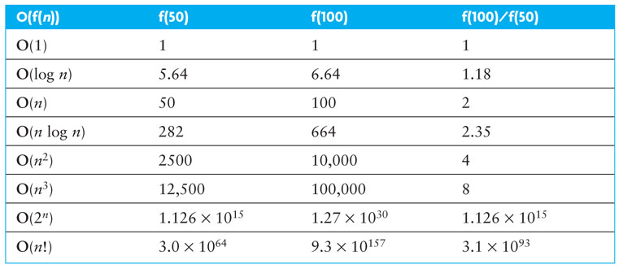
Effects of Different Growth Rates

Slide 160
Algorithms with Exponential and Factorial Growth Rates
Algorithms with exponential and factorial growth rates have an effective practical limit on the size of the problem they can be used to solve
With an O(2^{n}) algorithm, if 100 inputs takes an hour then,
101 inputs will take 2 hours
105 inputs will take 32 hours
114 inputs will take 16,384 hours (almost 2 years!)

Slide 161
Algorithms with Exponential and Factorial Growth Rates (cont.)
Encryption algorithms take advantage of this characteristic
Some cryptographic algorithms can be broken in O(2^{n}) time, where n is the number of bits in the key
A key length of 40 is considered breakable by a modern computer,
but a key length of 100 bits will take a billion-billion (10¹⁸) times longer than a key length of 40

